Slide 1
Understanding Tobacco Use Patterns: A Comprehensive Survey Analysis
KAJAL JAIN
CHEARS Internship
Department of Public Health
June 2023

Slide 2
Introduction
Tobacco use remains a significant public health concern worldwide, contributing to a range of preventable diseases and premature deaths.
To understand the prevalence, patterns, and associated factors of tobacco use, researchers and public health organizations conduct surveys to gather data directly from individuals.
The Behavioral Risk Factor Surveillance System (BRFSS) is one prominent example of a widely used tobacco use survey conducted in the United States.
The BRFSS collects data on a range of health-related behaviors, including smoking, through telephone interviews with respondents from various states and territories.

Slide 3
Objective
This project's objective is to analyze a tobacco use survey dataset to gain insights into smoking patterns among demographic groups such as gender, race, age, and education.
It Investigates the variations in tobacco use prevalence across different geographic locations (states, regions, etc.)
It analyzes the data over multiple years to identify trends in smoking prevalence.
It tries to determine the prevalence precision as the sample size indicates the precision
or reliability of the estimates derived from the data. Generally, larger sample
sizes tend to provide more precise estimates with smaller margins of error, while
smaller sample sizes may lead to less reliable estimates.
The project aims to contribute to public health initiatives by providing evidence-based recommendations for tobacco control strategies.

Slide 4

Methodology
Data Source and Collection-
The Tobacco Use Survey dataset from the Behavioral Risk Factor Surveillance System (BRFSS) generates data through the Centers for Disease Control and Prevention (CDC). Then the data was collected from this site as they provide open-source data to analyze.
2. Data Cleaning-
removing rows that have values that are missing,
changing the data type of some values within a column, and
removing columns that are not relevant to this task.
3. Descriptive Analysis -
Perform descriptive analysis to understand the basic characteristics of the dataset, including summary statistics, frequency distributions, and visualizations.

Slide 5
4. Data Modelling-
Analyze smoking prevalence over multiple factors to analyze the trend. Now we draw the insights of our data to make it for future use. Data can be visualized using Excel, pivot table, python, etc.
5. Create a Dashboard-
Now the final dashboards are created to explain all the conclusions that we draw.

Slide 6
Now as we know that already the dataset is provided to us.
Let’s start by cleaning the data
So all the columns which are irrelevant to the analysis will be deleted and all the missing values rows will be deleted.
Now we draw some meaningful insight using Excel according to the question:

Slide 7
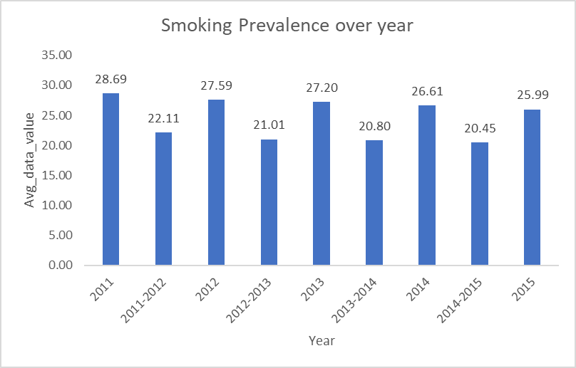
Results:
Trend in Smoking Prevalence over the Year

Slide 8
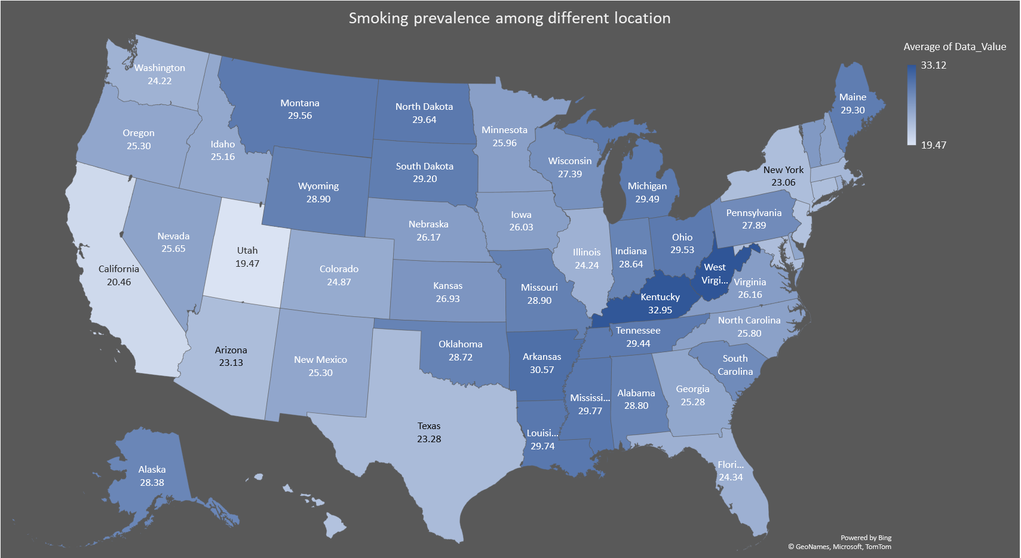
Geographic Variation in Tobacco Use

Slide 9
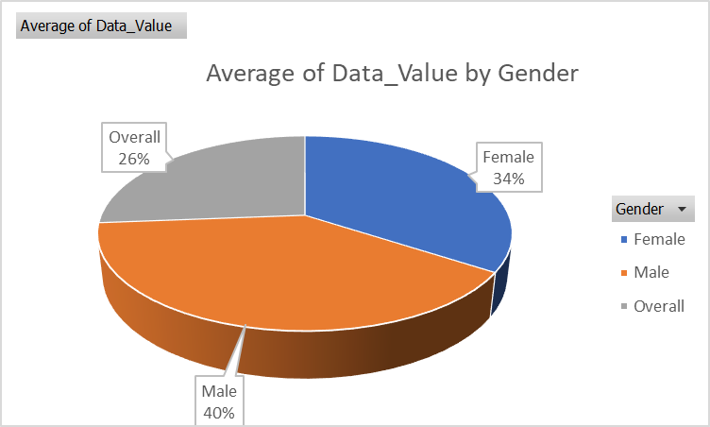
Explore disparities in tobacco use prevalence among different demographic groups, such as gender, race/ethnicity, age, and education level.

Slide 10
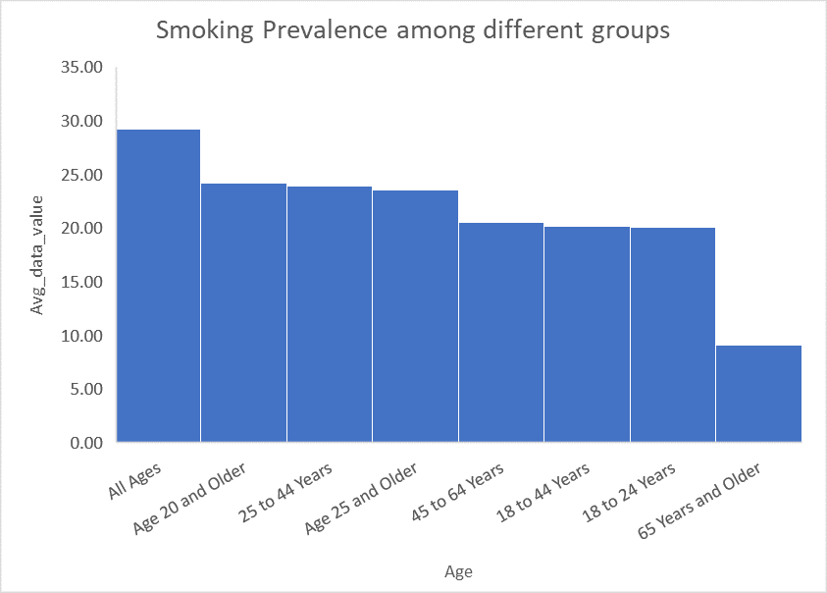
Tobacco use prevalence in different age groups

Slide 11
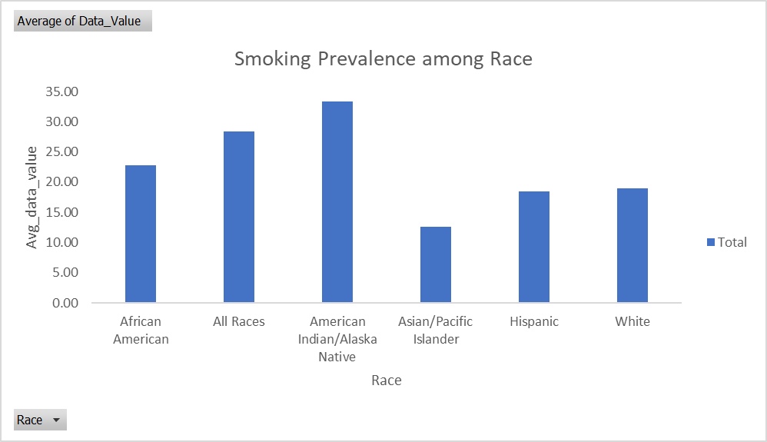
Trend in Smoking Prevalence among Race

Slide 12
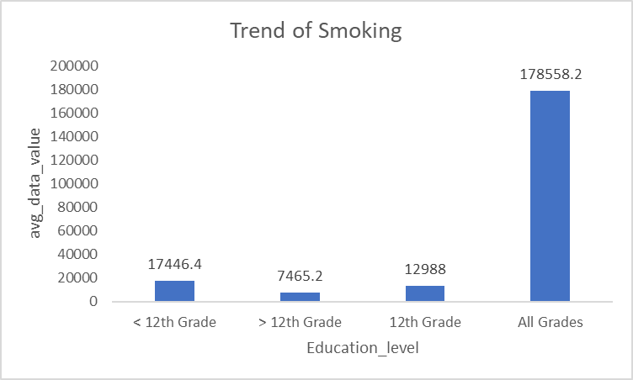
Trend in Smoking Prevalence among different levels of educated people

Slide 13
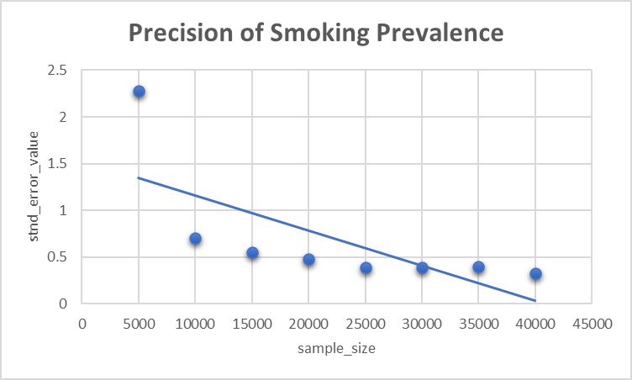
Precision of Estimates: The sample size provides an indication of the precision or reliability of the estimates derived from the data.
It shows that larger sample sizes tend to provide more precise estimates with smaller margins of error, while smaller sample sizes may lead to less reliable estimates.

Slide 14
Thank You

